Slide 1
FlyFiler
Created by,
Rupali Tasnim Samad
1208
Supervised by,
Dr. B M Mainul Hossain
Associate Professor, IIT DU

Slide 2
What is FlyFiler?
File Management System
Main Menu to Choose
Operations
Register and
Login

Slide 3
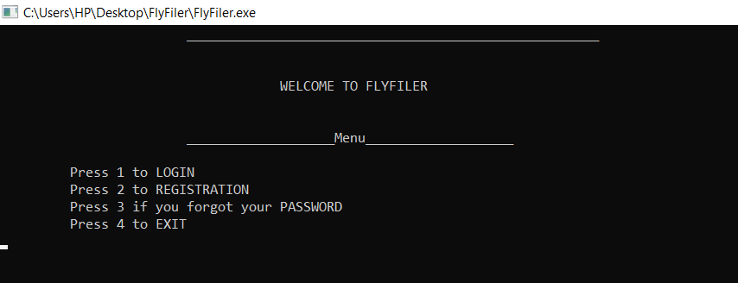
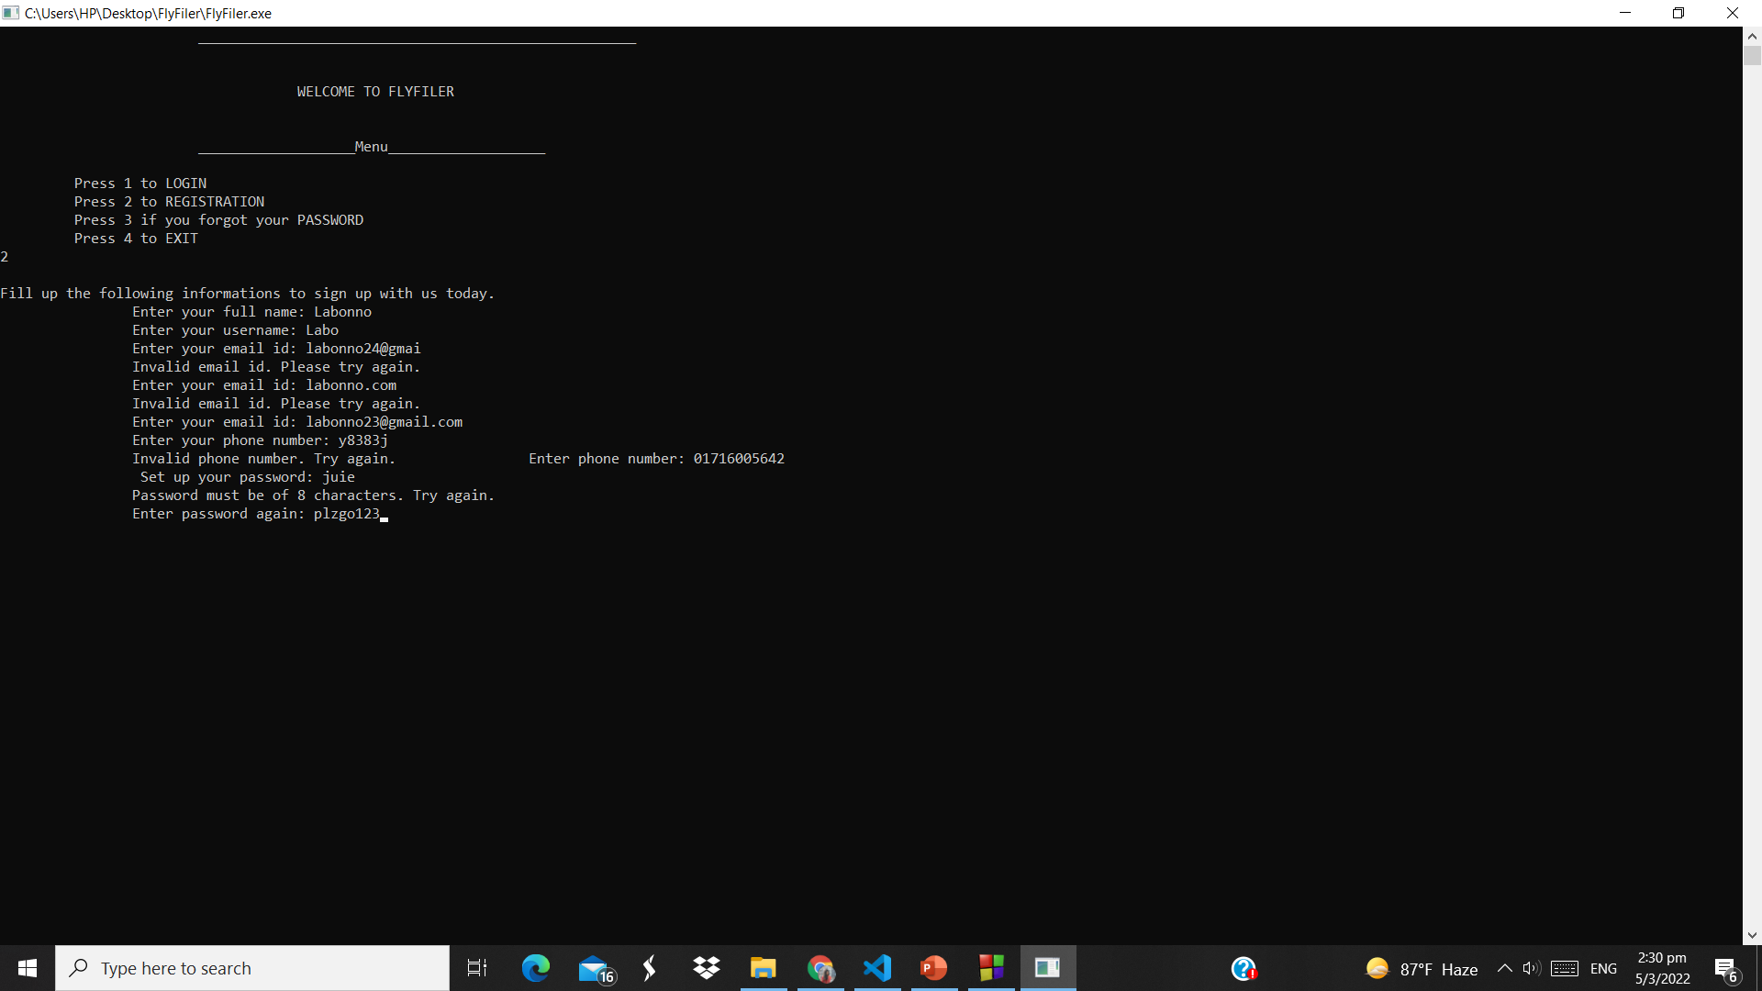

Slide 4
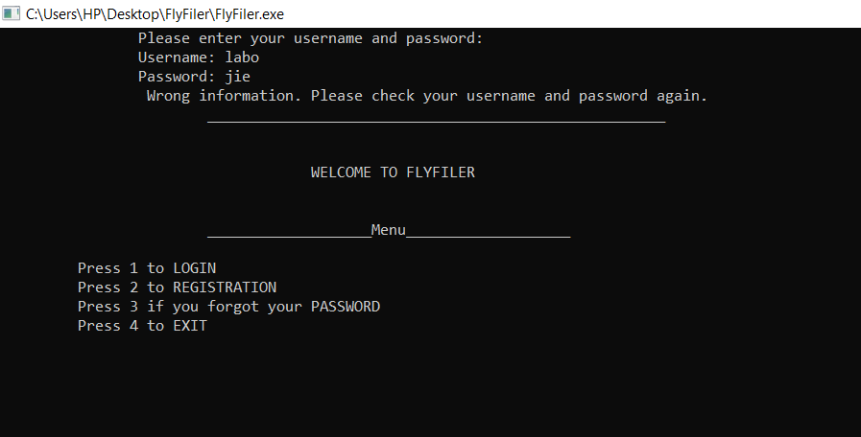



Slide 5
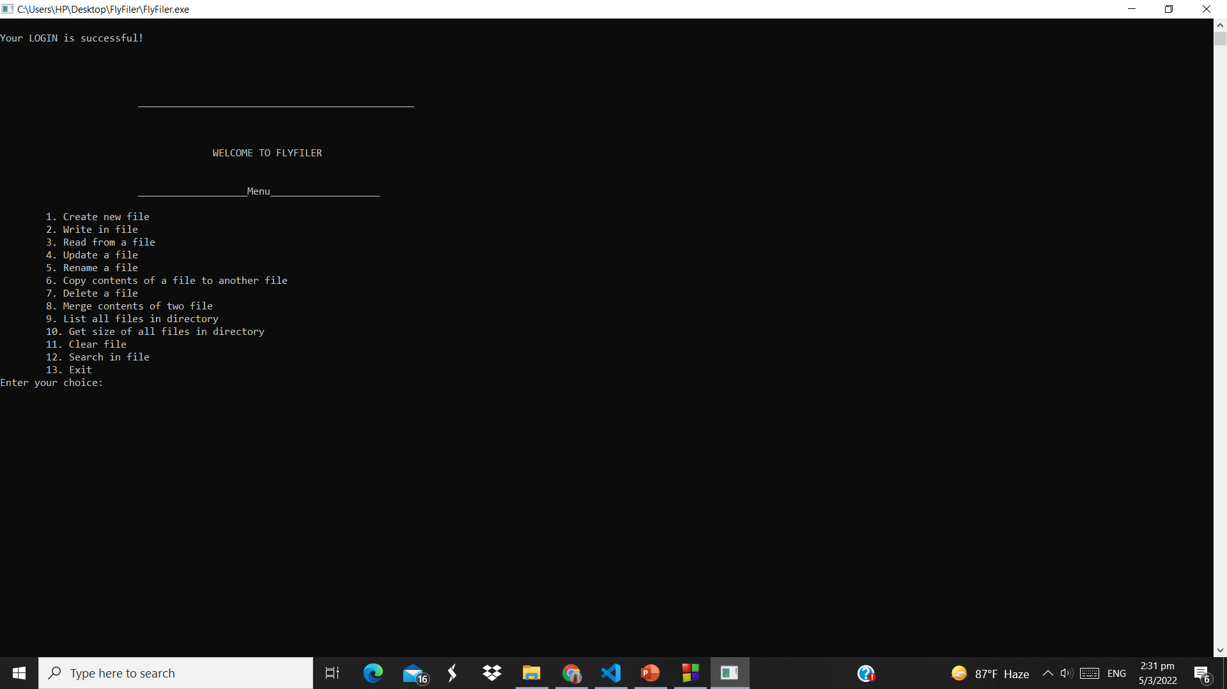

Slide 6
Motivation behind the project
Important to organize our digital documents.
Assist the user to be more coordinated.
Implements almost all the feature necessary to create a digital record of documents.
Suits the criteria of spl-1 because it needs raw coding to a large extent.

Slide 7
Challenges
Background study about windows system programming
Learn in details about file operations
Study about encryption decryption algorithm
Cpp language learning
Faced so far..

Slide 8
Progress So Far…
Login-Registration Portal
Create New File
Write in File
Read from File

Slide 9
Continued…
Update a File
Copy Contents of File
Rename a File

Slide 10
Continued…
List Files from Directory
Get Size of Directory Files
Clear Contents of File
Merge Contents of two Files
Remove a File

Slide 11
Search Option Menu
Search word and number of occurrences
Search character and number of occurrences
Find longest word in File
Find shortest word in File
Count number of lines in File
Find if any digit in present in File

Slide 12
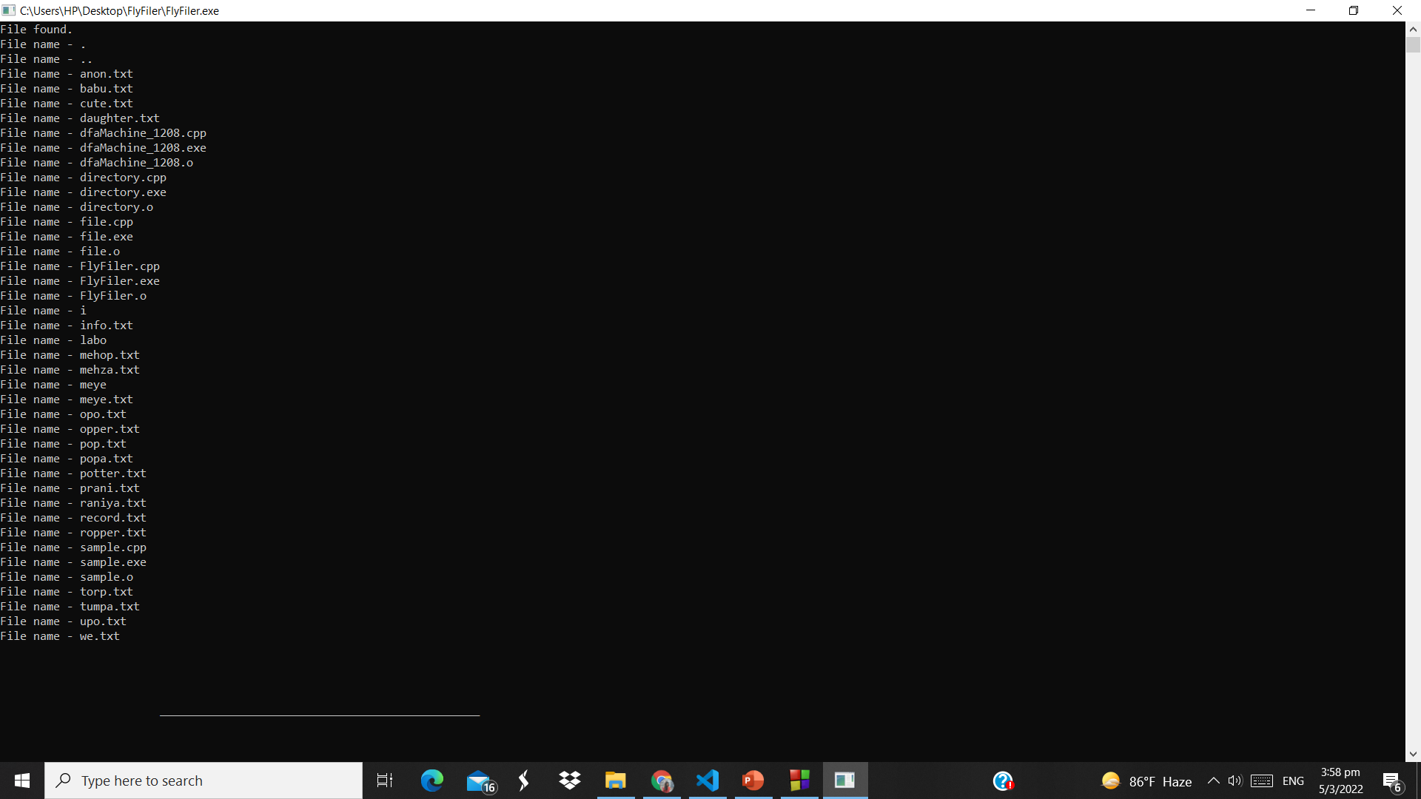



Slide 13


Slide 14
More things
Encrypt or decrypt a text file
File compression
Updating the search menu
To implement…

Slide 15
GitHub Link for the project -
https://github.com/Labonnya/FlyFiler
Thank you!

